Slide 1
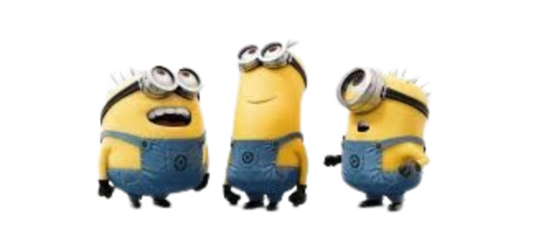
Deliverable 2

Slide 2

UML Class Diagram
https://tinyurl.com/282fp4km

Slide 3

Task Division
Daniel
Emotional support & Helper
Checkers
Setting up board
Getting legal moves
Applying/undoing moves
Stuff with checkers
Alex
Emotional support & Helper
Self-training loop
Partially connect Neural Net
Sebastian
Helper & emotional
Convolutional layer structure and forward pass
Monte Carlo Tree Search
Georges
Cheerleader
Dense Layer and Residual block classes
Backward pass
Weight Updating

Slide 4

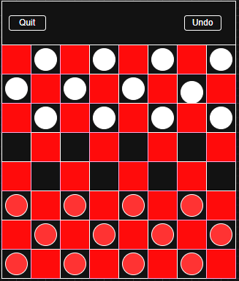
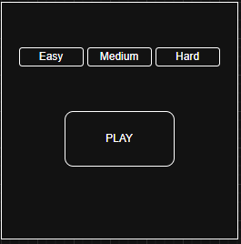
Mockup

Slide 5
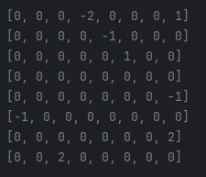
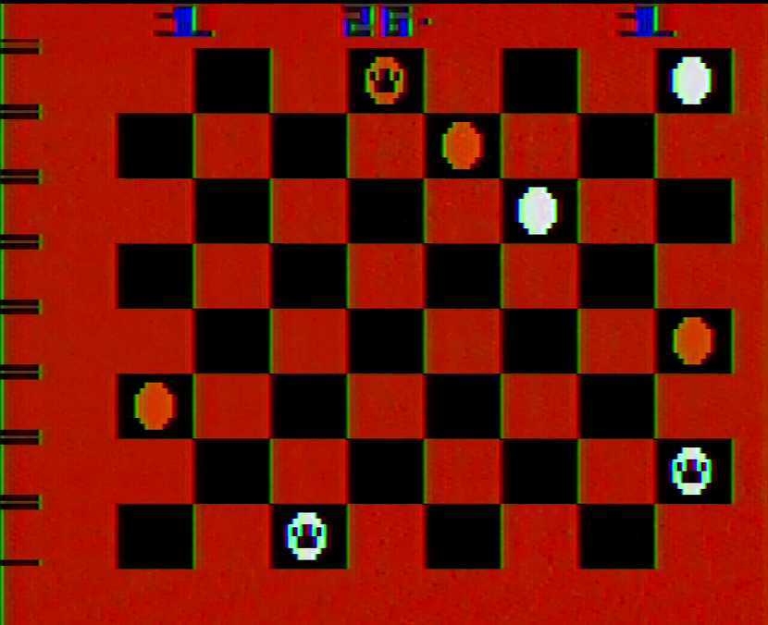
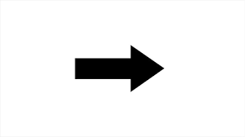
Sample Input and Output Data Grid - Input Processing

Slide 6
Sample Input and Output Data Grid - Output Example
Output as a list of moves and the chance of the move being the best one
Ex: (A6 -> B7: 60%, C3 -> B2: 35%, F4 -> E5: 5%)
Ideal (Ex): (A6 -> B7: 98.5%, C3 -> B2: 1.0%, F4 -> E5: 0. 5%)

Slide 7
Project Management
Jira
User stories & Tasks
Sub-Tasks (Implementation)

Slide 8
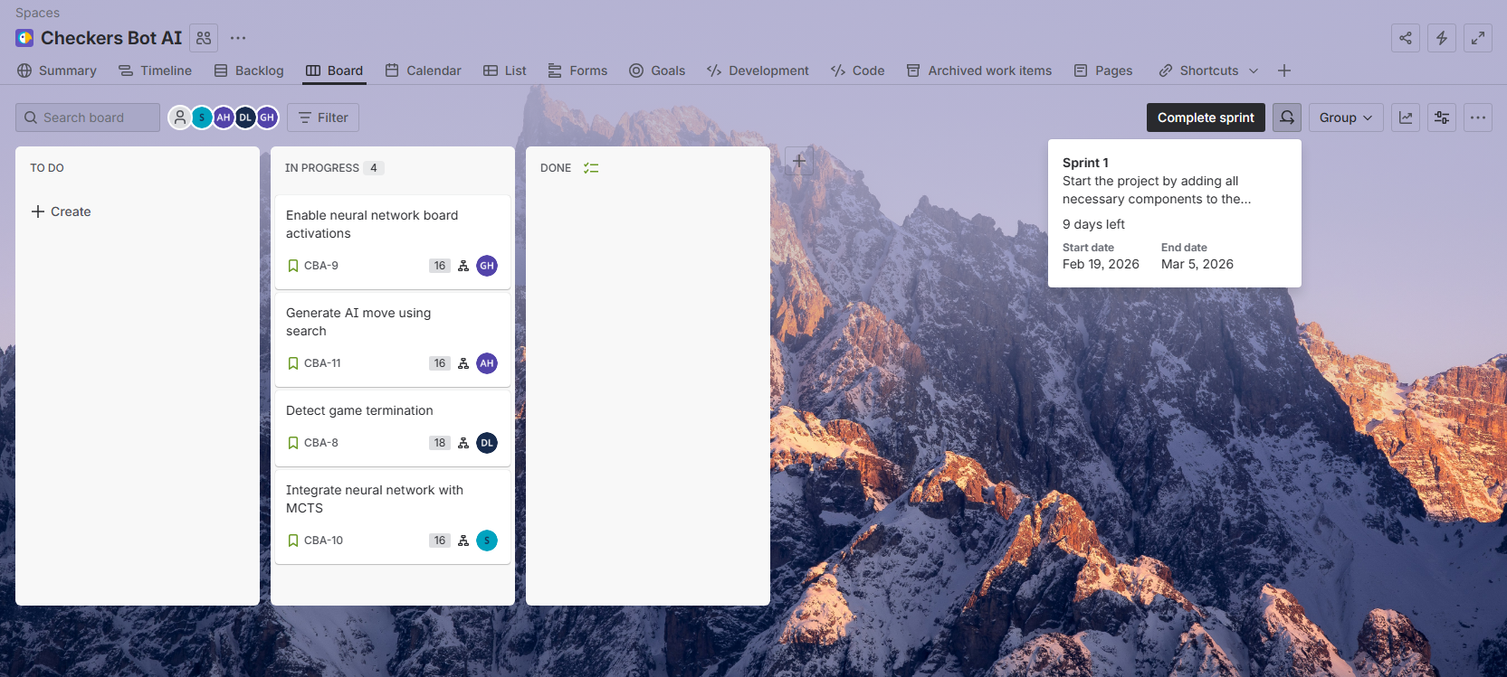
Sprint 1 - User Stories and Tasks

Slide 9
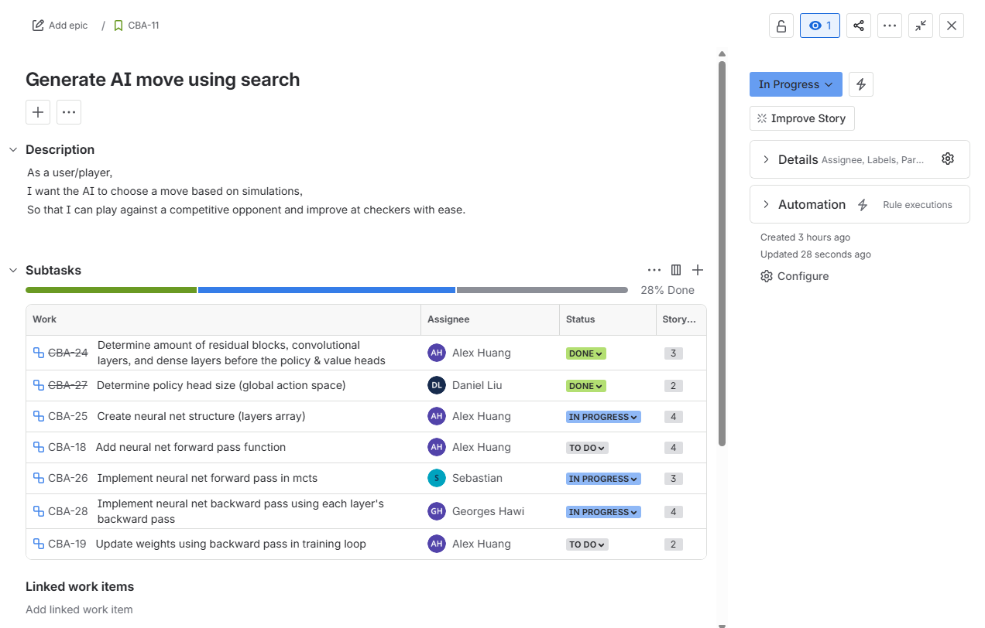
Sprint 1 - Subtasks (Example)

Slide 10
Sprint 1 - Sprint Report
Daniel
Sebastian
Received Stories | Resolved Stories | Carry Over Stories
CBA-8 (20/24) | CBA-8 (15/24) | CBA-8 (2/24)
CBA-9 (2/20) | CBA-10(3/20) | CBA-9(2/20)
CBA-10 (3/20) | CBA-11(2/24)
CBA-11 (2/24)
Received Stories | Resolved Stories | Carry Over Stories
CBA-8 (3/24) | CBA-8 (3/24) | CBA-9 (3/20)
CBA-9 (3/20) | CBA-10 (12/20) | CBA-10 (3/20)
CBA-10 (15/20) | CBA-11 (3/22)
CBA-11 (3/22)

Slide 11
Sprint 1 - Sprint Report
Alex
Georges
Received Stories | Resolved Stories | Carry Over Stories
CBA-9 (2/20) | CBA-9 (2/20) | CBA-10 (3/20)
CBA-10 (3/20) | CBA-11 (13/22)
CBA-11 (13/22)
Received Stories | Resolved Stories | Carry Over Stories
CBA-8 (3/24) | CBA-8 (3/24) | CBA-9 (2/20)
CBA-9 (14/20) | CBA-9 (12/20) | CBA-10 (3/20)
CBA-10 () | CBA-11 (4/22)
CBA-11 ()

